Slide 1
Spring Cloud Config
&
Spring Cloud Bus
Erol Hira
Turkcell | BiP

Slide 2
Ajanda
Konfigürasyon Merkezileştirme İhtiyacı
Spring Property Management
Spring Cloud Config
Bootstrap Context
Konfigürasyon Güncelleme Stratejileri

Slide 3
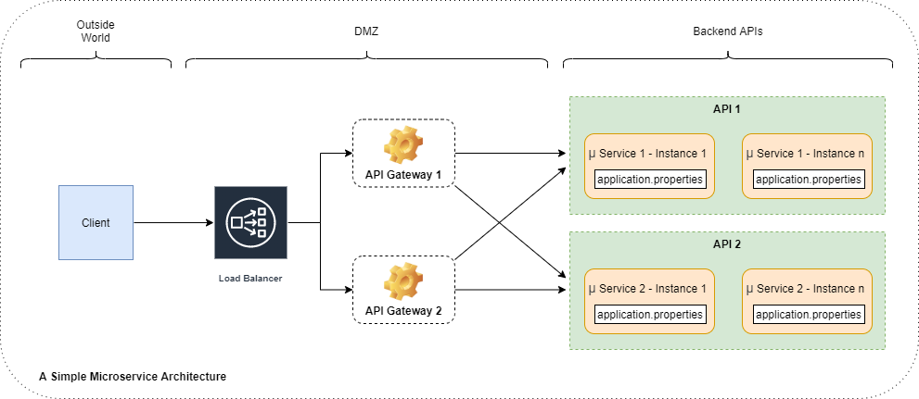
Problem
Service Count & Instance Count
Configuration Change / Update
Shared Configurations

Slide 4
12-Factor App Manifesto
https://12factor.net/config
‘An app’s config is everything that is likely to vary between deploys.’
Strict separation of config from code
Store config in ‘environment’ variables
  Seperate the configuration environment from the deployment environment.
Any change to config, just like with a change to code, results in a new release.

Slide 5
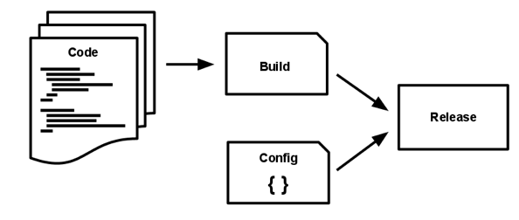
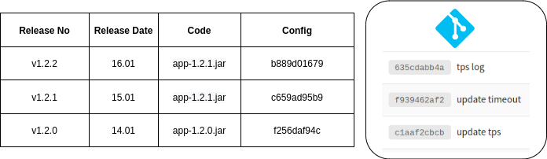
12-Factor App Manifesto
III. Config
V. Build, release, run

Slide 6
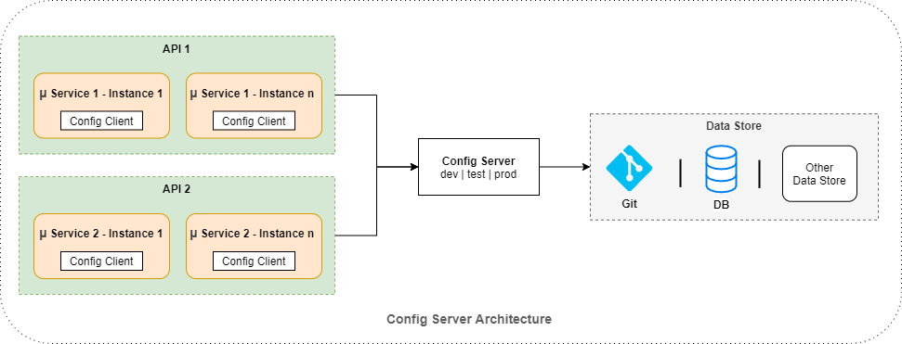
Spring Cloud Config
https://spring.io/blog/2015/01/13/configuring-it-all-out-or-12-factor-app-style-configuration-with-spring

Slide 7
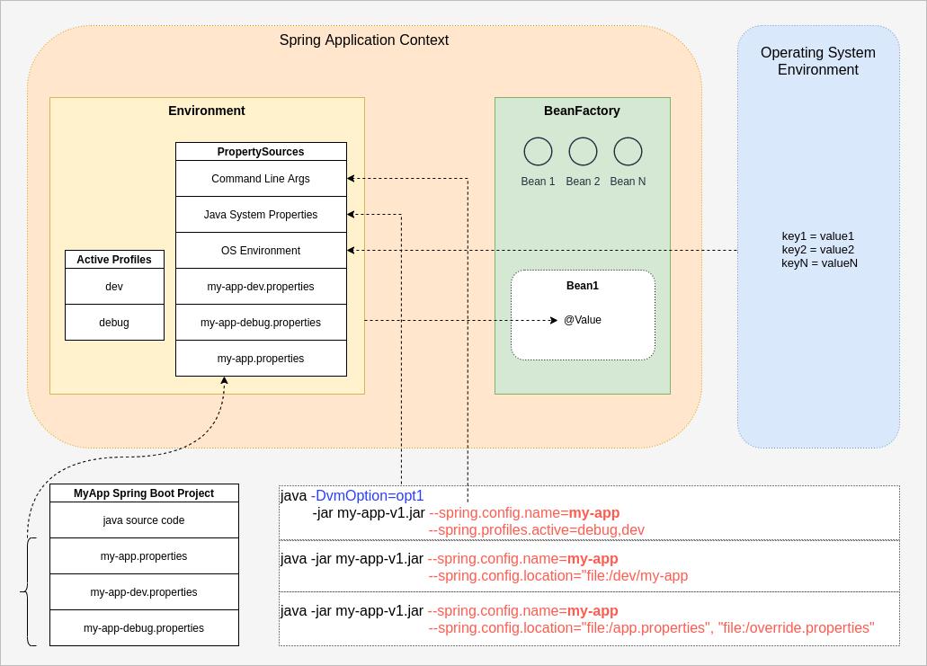
Spring Property Management

Slide 8
Spring Property Binding
Environment
→ @Autowired Environment environment;
→ environment.getProperty("prop-1");
@Value
@Value("prop-1")
private String prop1;
@ConfigurationProperties
@ConfigurationProperties
public class AppConfig {
private String prop1;
private String prop2;
}

Slide 9
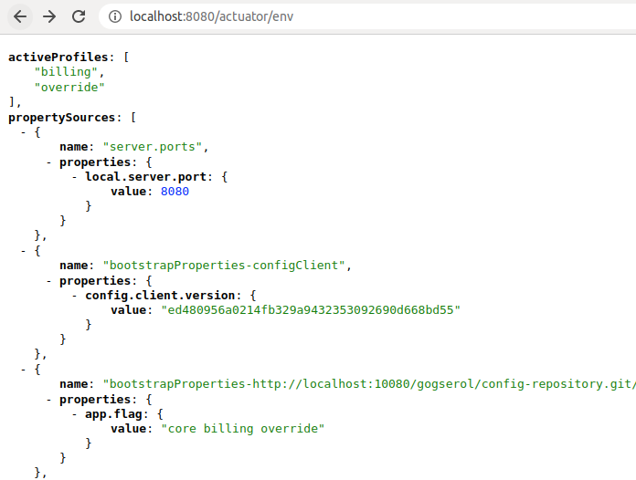
Display Environment Properties

Slide 10
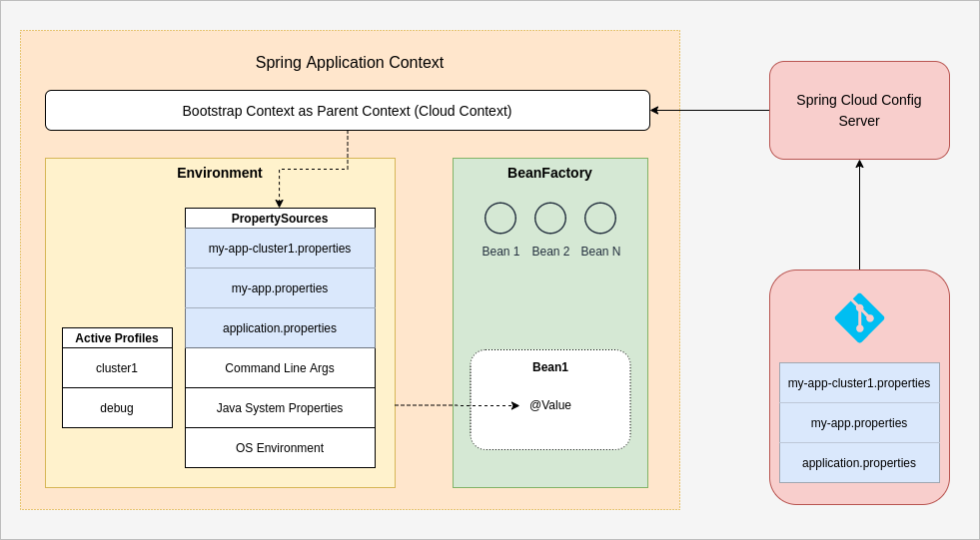
Spring Cloud Config Property Management

Slide 11
Config Server Application
Dependencies – pom.xml
Enabling config server
@EnableConfigServer
Configure bootstrap.properties

Slide 12
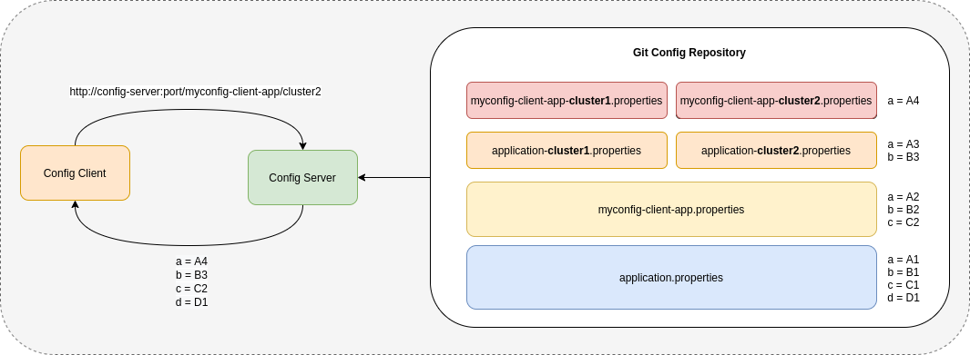
Property File Naming & Configuration Overriding
- application.properties [.yml]
- [application-name].properties [.yml]
- [application-name]-[profile].properties [.yml]

Slide 13
Config Server Url
http://config-server-host:port/[application_name]/[profile]/[label]
application_name
profile
label
http://config-server/myapp/dev,bulk/v2
myapp-bulk.properties
myapp-dev.properties
myapp.properties
application.properties
application-...

Slide 14
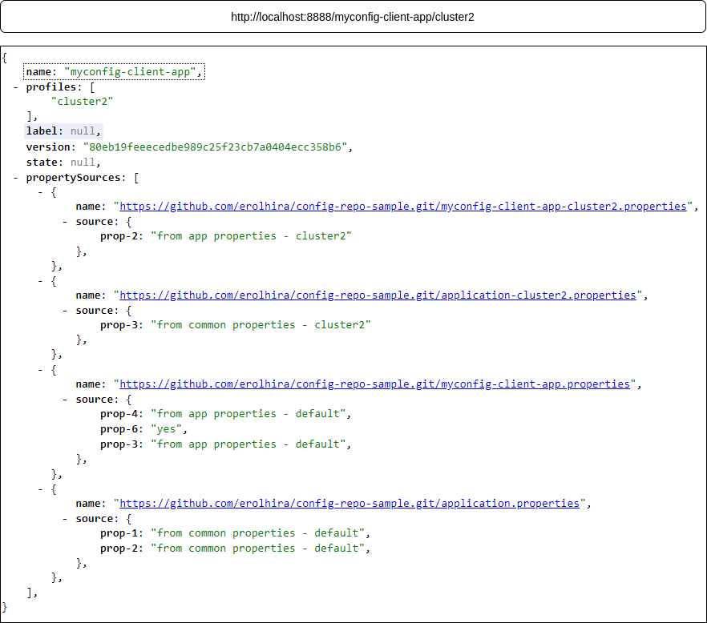
Configuration Request

Slide 15
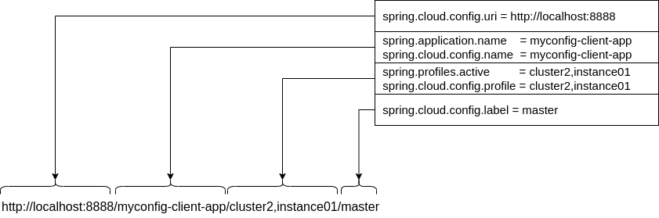
Config Client Application
Dependencies – pom.xml
Configure bootstrap.properties
spring.cloud.config.uri → comma-seperated

Slide 16
Profile
spring.profiles.active=billing,override,v2
spring.cloud.config.profile=billing,override,v2
last-wins strategy
Active profiles take precedence over defaults.
Usage
  Seperate environments
  Override properties
  myapp-dev.properties | myapp-istanbul.properties
  myapp-prod.properties | myapp-ankara.properties

Slide 17
Label
branch, tag, commit id
spring.cloud.config.label = v2, master
first-existed-branch wins
master
spring.cloud.config.server.default-label
Usage
  Versioned set of configurations
  Rolling back to previous versions of configuration.
  Seperate environments

Slide 18
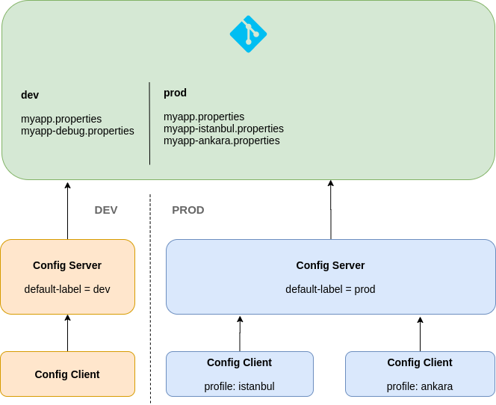
Label & Profile

Slide 19
search-paths
Root Folder + search-paths
spring.cloud.config.server.git.search-paths=billing, catalog*
spring.cloud.config.server.git.search-paths={application}
Sample
/application.properties
/billing/application.properties
/billing/core-billing.properties
/billing/billing-jobs.properties
/catalog/application.properties

Slide 20
Property Refresh
Spring Boot Actuator
  /actuator/refresh
Spring Cloud Bus
  /actuator/bus-refresh
  /monitor

Slide 21
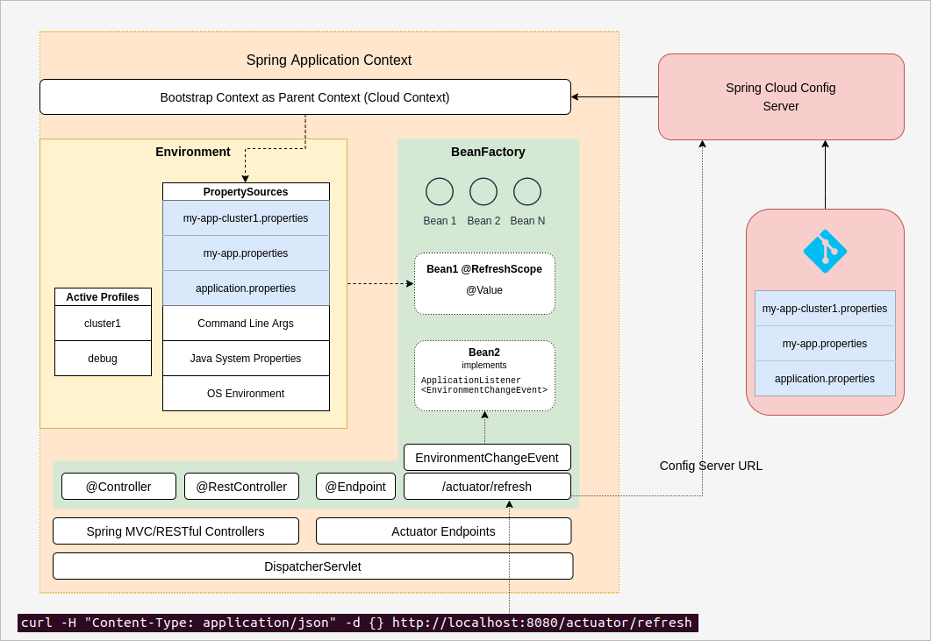
Actuator RefreshEndpoint

Slide 22
Refresh Properties
Environment
@ConfigurationProperties
@Value needs @RefreshScope
@Service
@RefreshScope
@Getter @Setter
public class RefreshScopedService {
@Value("#{new Boolean(new String('yes').equals('${prop-6:false}'))}")
private Boolean prop6;
}
EnvironmentChangeEvent

Slide 23
Spring Cloud Bus
Lightweight message broker
Broadcast state/configuration changes
Supported AMPQ brokers
  Kafka
  RabbitMQ
Endpoints
  /actuator/bus-env
  /actuator/bus-refresh

Slide 24
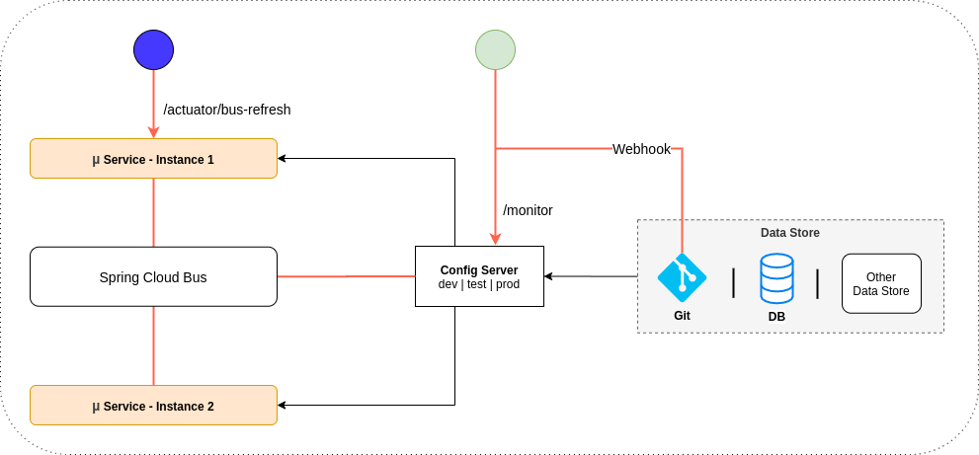
Spring Cloud Bus

Slide 25
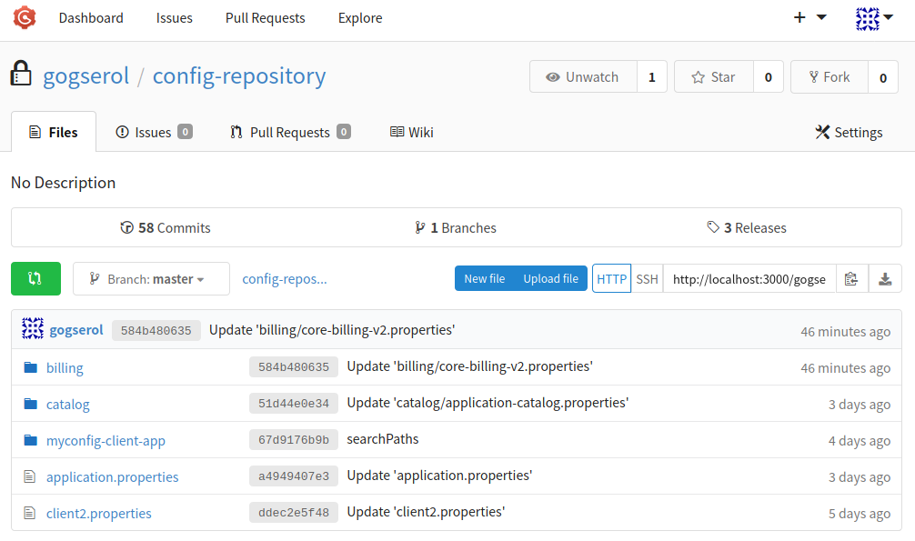
Gogs
Self-hosted Git service
MIT License
https://github.com/gogs/gogs

Slide 26
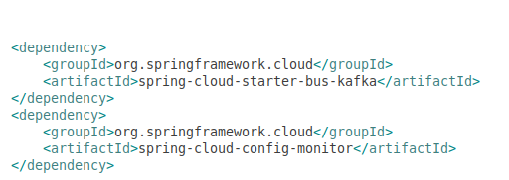
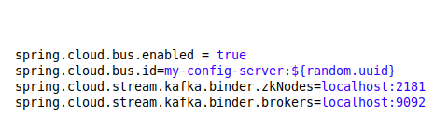
Spring Cloud Bus – Config Server
pom.xml
bootstrap.properties

Slide 27
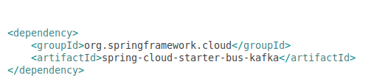
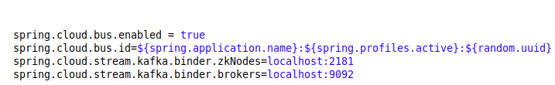
Spring Cloud Bus – Config Client
pom.xml
bootstrap.properties

Slide 28
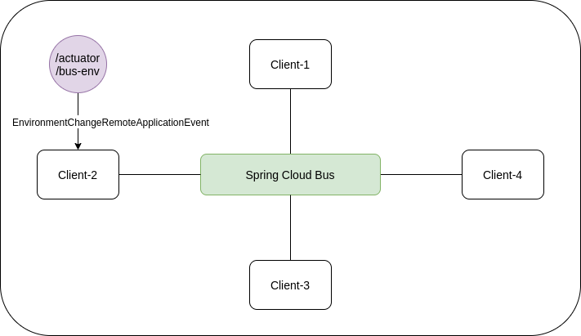
Spring Cloud Bus - Environment

Slide 29
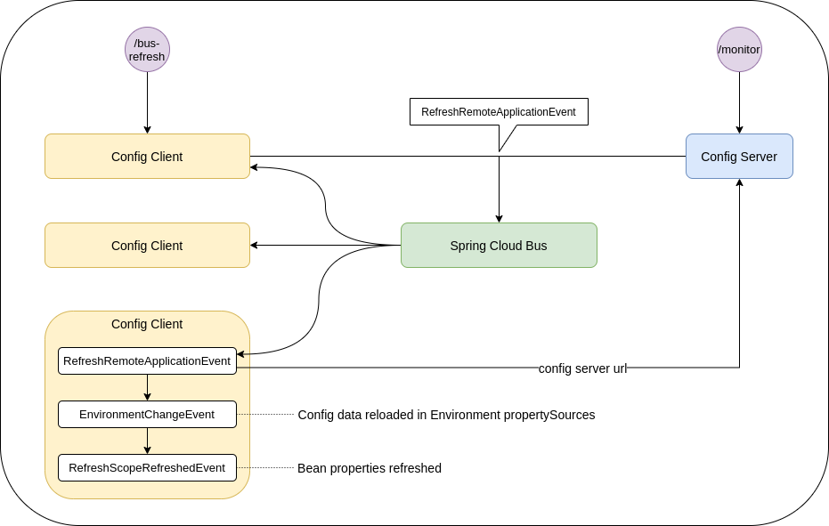
Spring Cloud Bus – Refresh Events

Slide 30
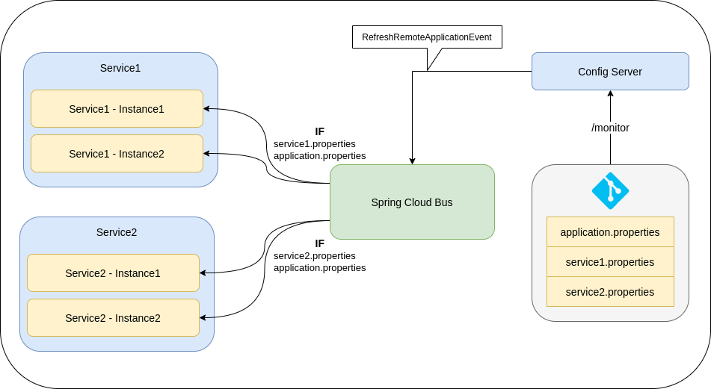
Events – Multiple Service

Slide 31
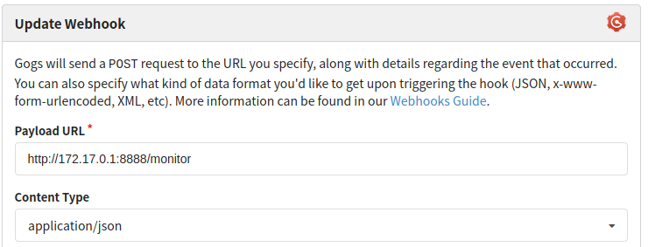
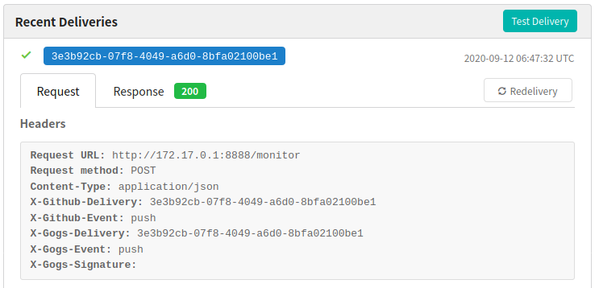
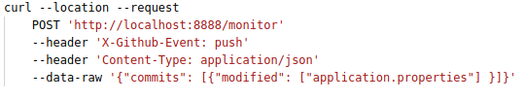
/monitor

Slide 32
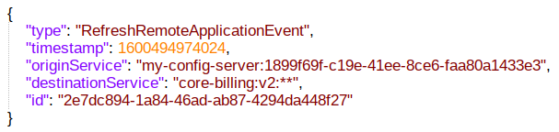
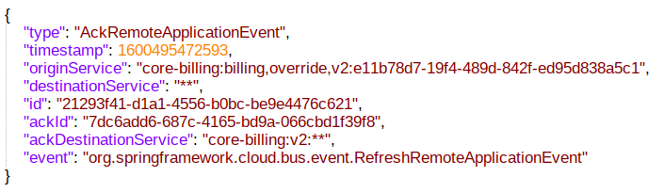
Event Messages

Slide 33
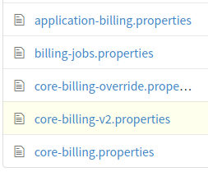
spring.cloud.bus.id
core-billing-v2.properties
Message-destinationService
  core-billing-v2:**
  core:billing-v2:**
  core-billing:v2:**
spring.cloud.bus.id
  ${spring.application.name}:${spring.profiles.active}:${random.uuid}
  core-billing:v2:*

Slide 34
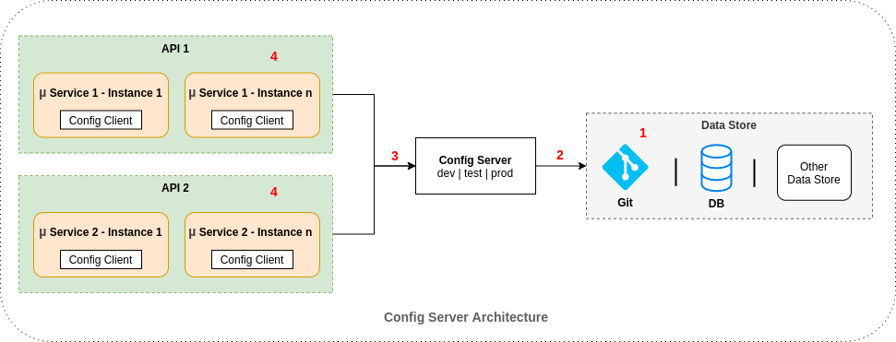
Cloud Config Security
Property Encryption
Authentication

Slide 35
Property Encryption
Spring Cloud Config Server supports property encryption.
curl localhost:8888/encrypt -d secretValue
curl localhost:8888/decrypt -d 5bcfd73b0903cd6d77f98f743cea126637519a70740c057844d5b3d9ee8c2046
encrypt.key = ${ENCRYPT_KEY}
secretProperty = {cipher}3abcfc4524e2c012b91
spring.cloud.config.server.encrypt.enabled
defaults to true for decryption before send

Slide 36
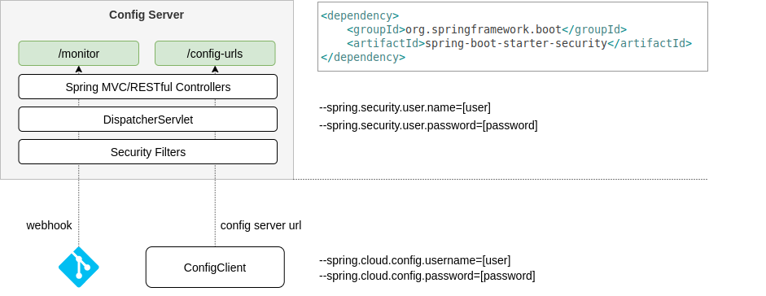
Authentication

Slide 37
Remarkables
spring.cloud.config.server.git.clone-on-start=true
multiple instances of config server, preferably behind a Load Balancer
spring.cloud.config.server.git.basedir
local working copy of repository
spring.cloud.config.server.git.force-pull = true
spring.cloud.bus.destination=my-config-bus
default: springCloudBus
spring.cloud.bootstrap.location
https://cloud.spring.io/spring-cloud-static/Hoxton.RELEASE/reference/html/spring-cloud-hoxton-configprops.html

Slide 38
TEŞEKKÜRLER
github.com/erolhira
linkedin.com/in/erolhira
blog.soshace.com/author/erol
javalopment.com

